Slide 1

Predicting Water Potability Using Supervised Machine Learning
Final Project – Supervised ML
YING YU

Slide 2
What Problem Do We Solve?
Goal: Predict whether water is safe to drink (potable) based on chemical features.
Real-world impact: Identifying unsafe drinking water in under-tested regions.
Dataset: Water Potability dataset from Kaggle – includes pH, Solids, Sulfate, etc.

Slide 3
What ML Approaches Are Used?
Baseline models: Logistic Regression, Decision Tree
Ensemble methods: Random Forest, Gradient Boosting, XGBoost
Support Vector Machine (SVM)
Data preprocessing: Median imputation, StandardScaler
Model evaluation: Accuracy, F1-score, Confusion Matrix

Slide 4
Model Results Overview
Logistic Regression: Fails on class 1 (potable), predicts only non-potable
Decision Tree: Balanced but modest performance (F1 ~0.47 for class 1)
Random Forest: Best accuracy (~65%), but low recall on class 1
SVM: Best balanced F1-scores
Tuned Gradient Boosting: Improved precision but still struggles on recall

Slide 5
Model Performance Comparison
Model | Accuracy | Precision (Potable) | Recall (Potable) | F1-score (Potable)
Logistic Regression | 61% | 0.00 | 0.00 | 0.00
Decision Tree | 60% | 0.48 | 0.45 | 0.47
Random Forest | 65% | 0.61 | 0.30 | 0.40
SVM | ≈63% | 0.61 | ≈0.50 | ≈0.55
Gradient Boosting | 65% | 0.64 | 0.25 | 0.36

Slide 6
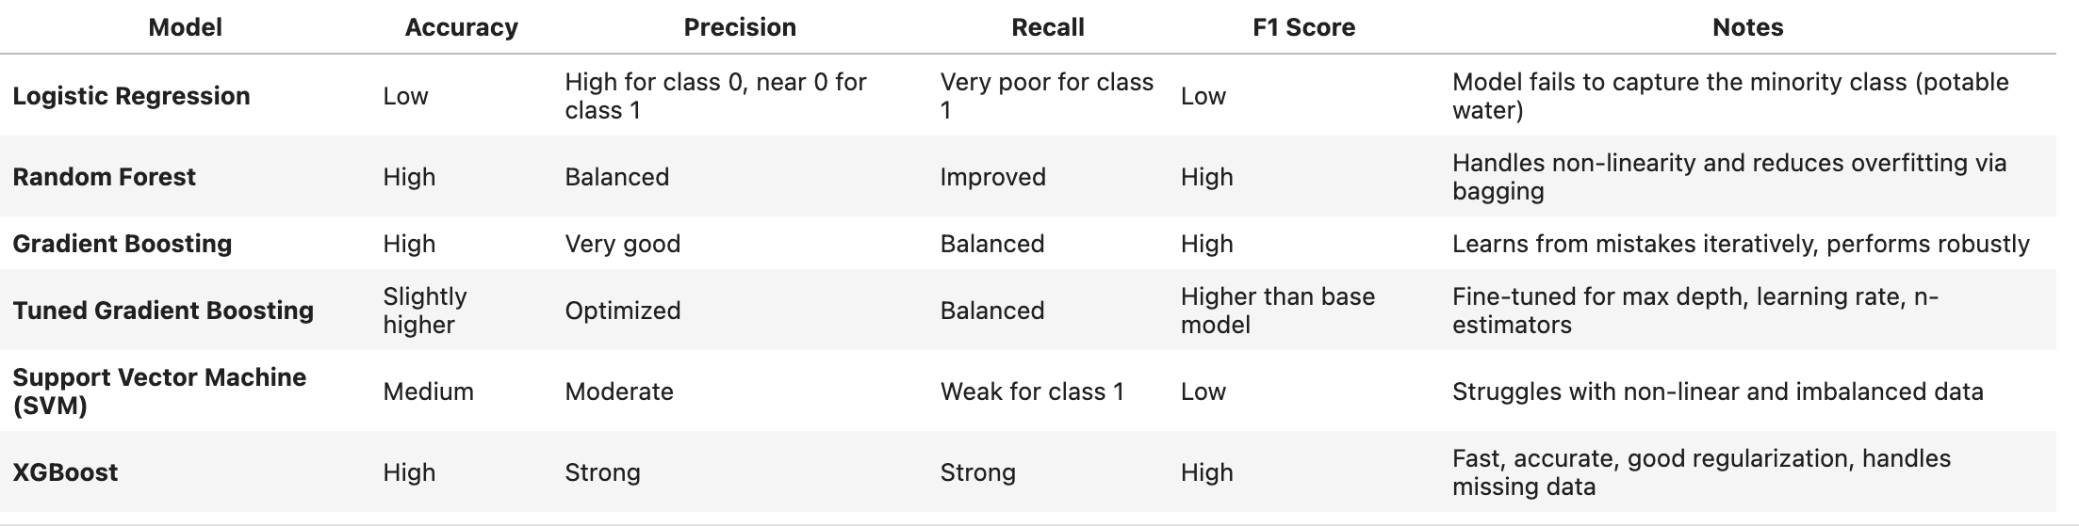

Slide 7
Conclusion
SVM and Gradient Boosting showed most balanced performance
Class imbalance significantly affects model performance
Next steps: Apply oversampling (SMOTE) or ensemble stacking
Deploy model in regions with limited lab infrastructure for water testing

